Slide 1
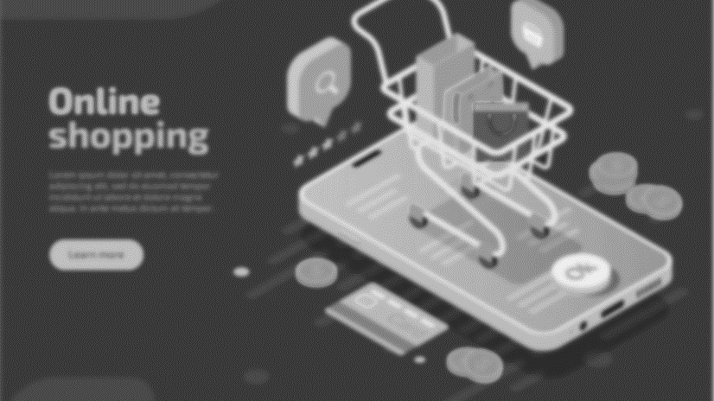
Presentation on e-commerce Portal “KASHMIR COMMERCIALS”
By Under the Supervision of
Himayat Habib (Group Leader) Dr. Umar Farooq
Wasil Khursheed
Sufiya Rehman
Tabish Handoo
MCA 4th Semester

Slide 2
Content:
AIM/OBJECTIVE
TECHNICAL DETAILS
INNOVATION
FEATURES

Slide 3
Aims/Objective
The website aims to develop an online market over the internet.
It will be in the form of an E-commerce portal which will allow users to advertise and sell their goods and services on the internet. This would permit them to make their wares available to users on a mass scale.
It will help people connect with one another for the purpose of trade and exchange of goods & service.
Its main objective is to provide and act as means of reaching out to other people on the internet.

Slide 4

Technical Details
The website will be divided into the following separate components
Content management system
The E-commerce Website / Portal
User Interface
Web Server
Website database

Slide 5

Content Management System
The website's backend will be managed by Database, which will be controlled by MySQL.
The data will be processed and managed accordingly using SQL queries.

Slide 6

The E-Commerce Website/Portal
The e-commerce website/portal will provide users a medium and interface through which they will buy and sell their services.
It will be written in HTML, CSS, JavaScript and JSP, which are popular scripting languages.

Slide 7

Website Database
The database of website will store all the information related to the articles (prices, descriptions, photos) and the users (name, contact number, email, location etc).

Slide 8
User Interface and Web Server
The design of the website will be completely based on HTML & CSS
The web server used for this website will be Apache TomCat.

Slide 9
Innovations
Single-click Checkout
Super Fast Delivery and Instant Pickup Counters
Real-Time Location-Based Mobile Selling
Social Commerce

Slide 10
Features and Benefits
Time-saving online marketing.
It is easy and free to use.
Buying/Selling
24 x 7.
You have to login and use it on the go.

Slide 11
Disadvantages
Unable to examine the product personally
Not everyone is connected to the internet.
Technical failures can cause unpredictable effects on the process.

Slide 12

Thank You!

